Slide 1
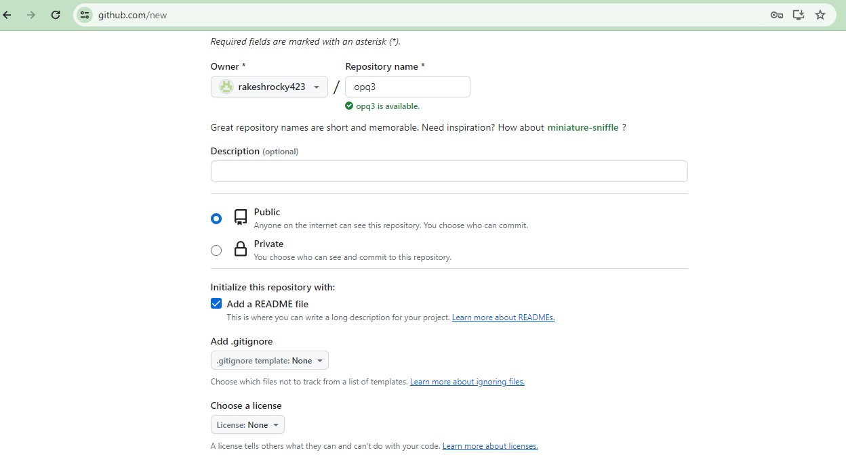
SAMPLE JOB FOR COLLABRATION 1) New repository creation by givin file name.. 2) Afters words select required fields like –publi –Read file after selecting these fields 3) Finall select the field create repository

Slide 2
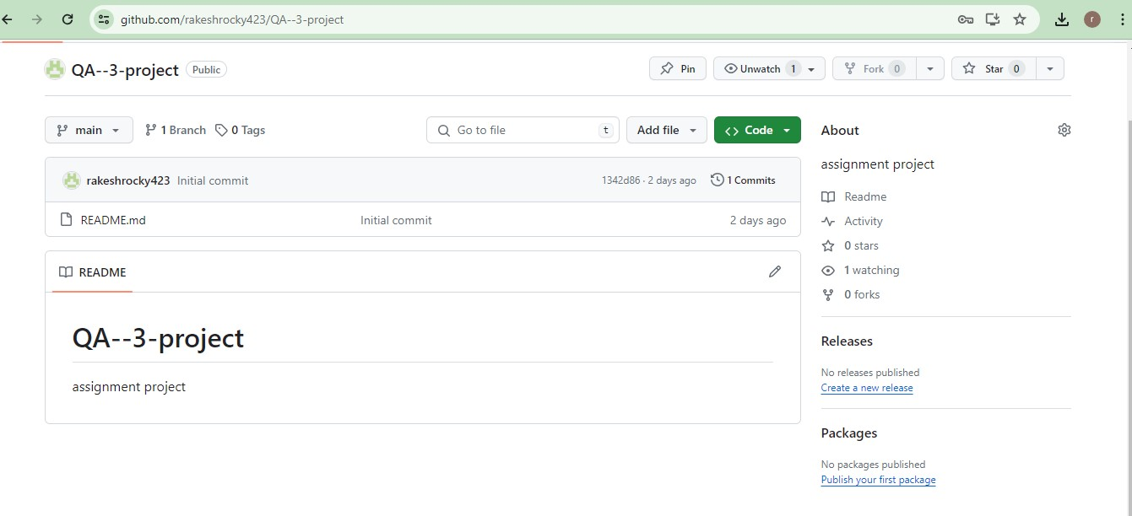
Project created

Slide 3
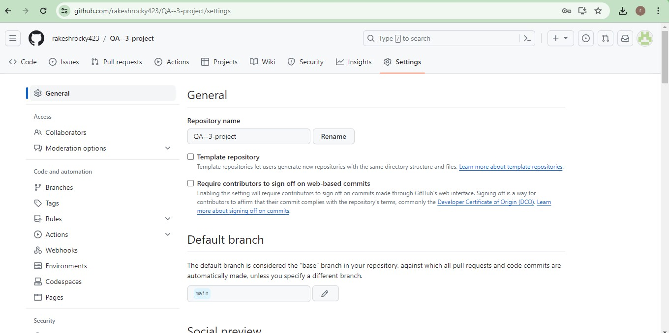
1) Step for adding collabroters 2) After selecting project it enters inside to the project 3) After entering select setting option in the dashboard 4) after entering option will find like collaboraters click on that

Slide 4
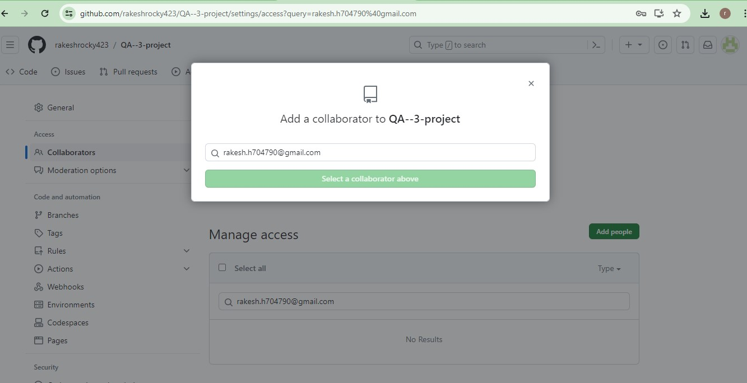
1) After entering in that option will shonw like add collaboraters to QA 2) Then goes on adding the people from their specified ID like gmail, or github account id 3) Sent invitations to those added people..

Slide 5
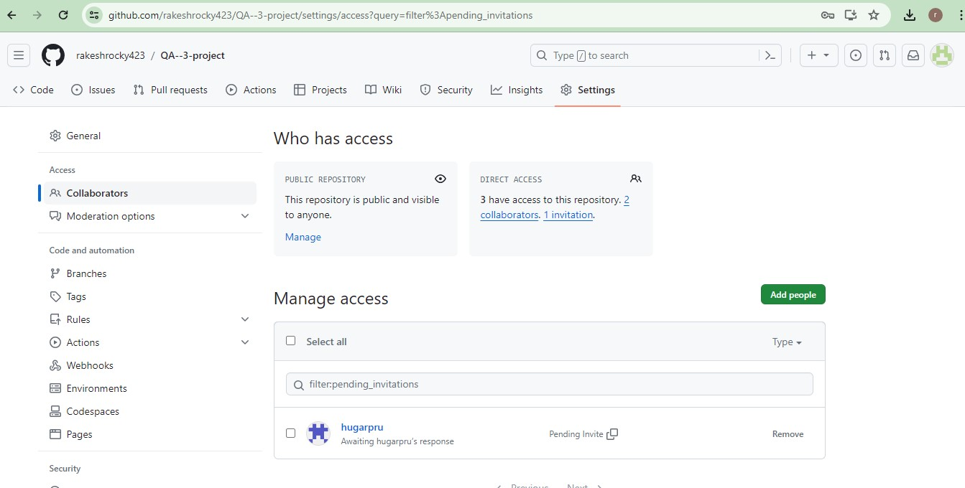
1) Below image will show 2persons collabrated , 1 person pending invitation at direct acces box will show clearley

Slide 6
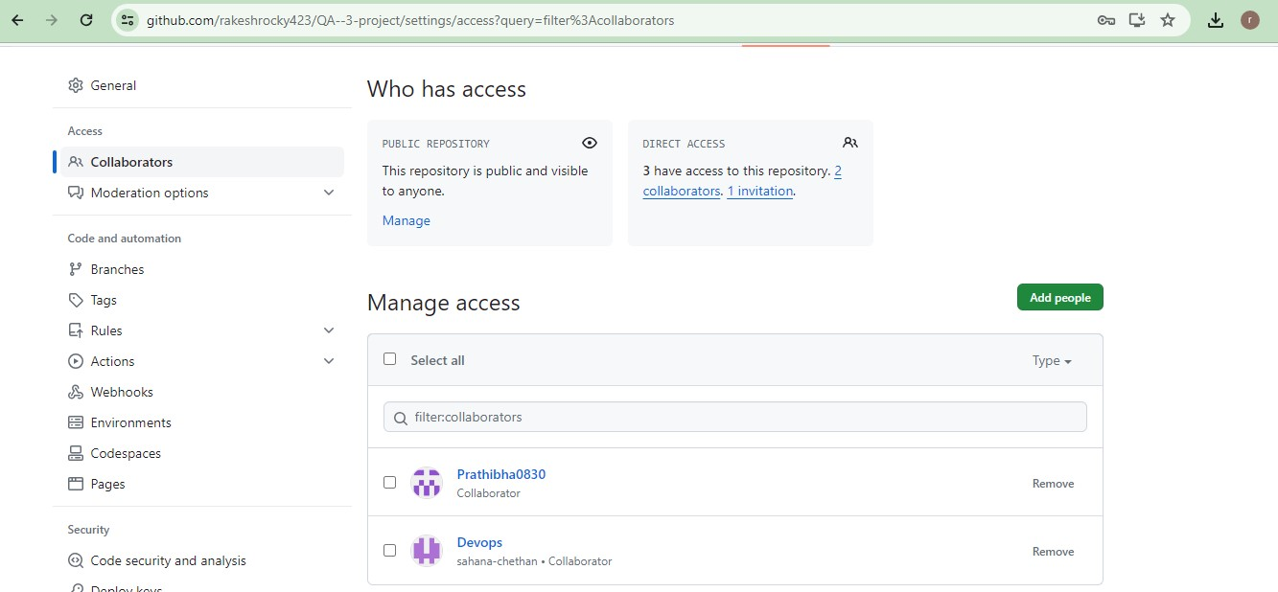
1) Below image will show collabrated persons 2) No of persons -2 collabrated

Slide 7
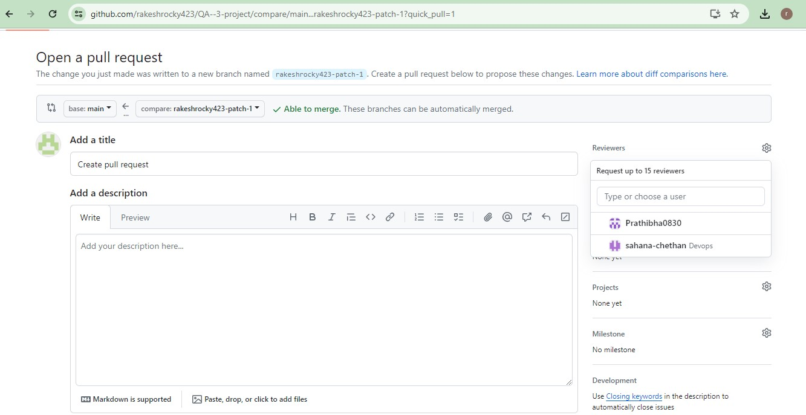
1) Created pull request for project review by the collabrated persons clearly it will shows in the below image..

Slide 8
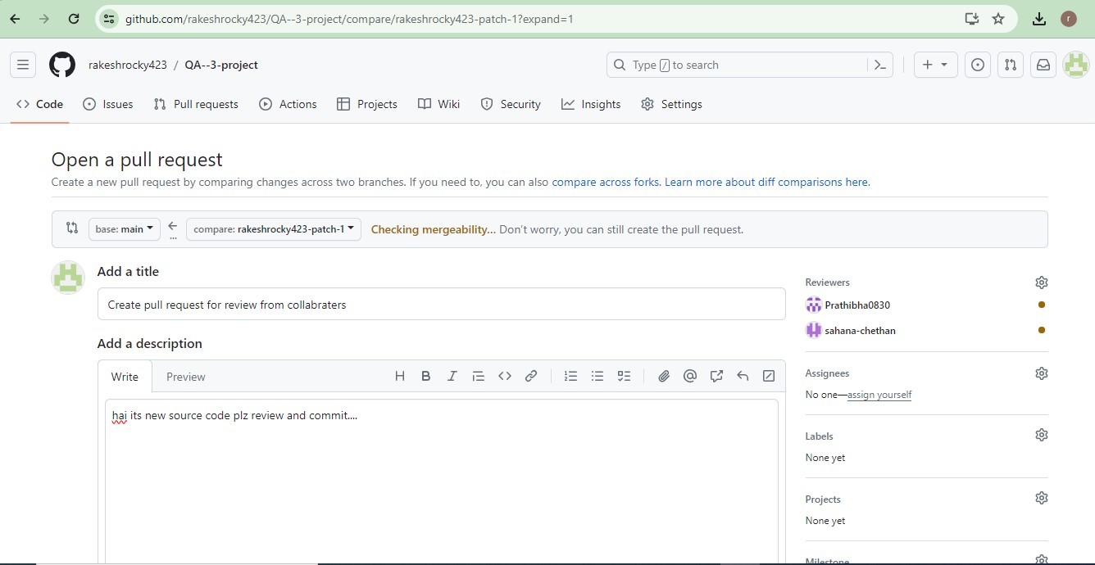
Adding some message in description to create request wth adding new branch .. Below image shown clearly

Slide 9
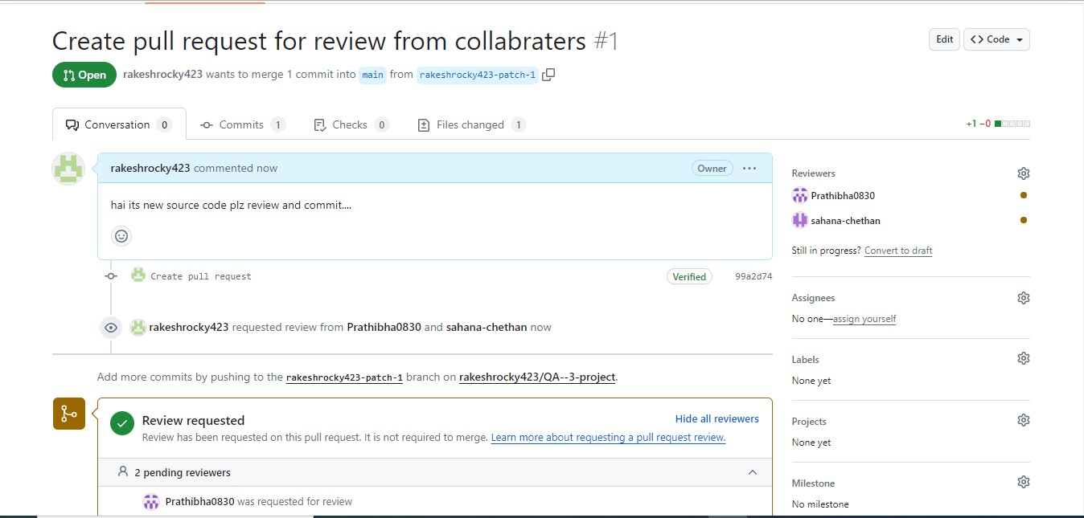
Created and sent pull request by adding collabraters for review the project

Slide 10
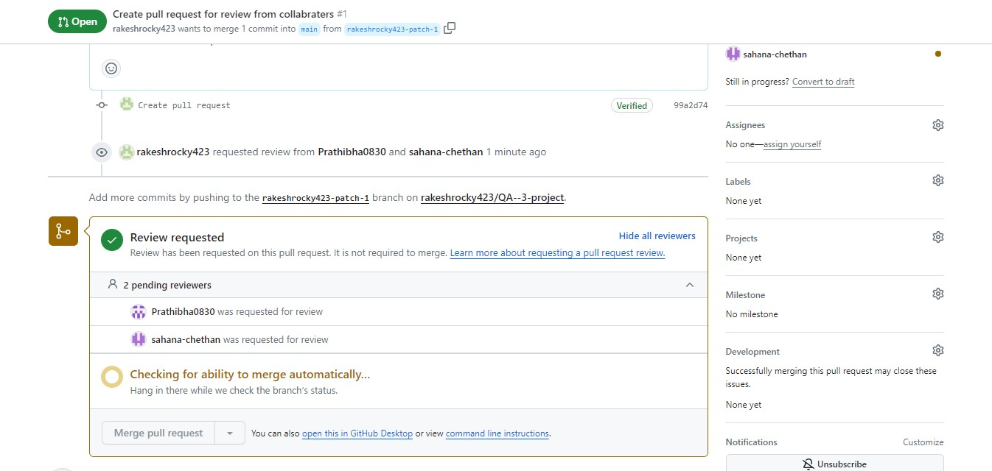
Raised review requested for review the project and waiting for response from reviewers….

